Slide 1
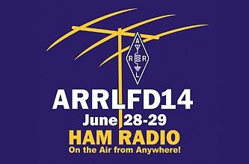
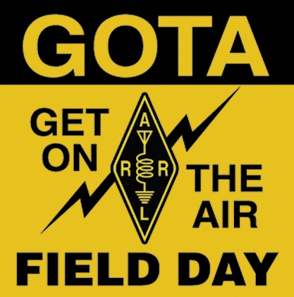
ARRL FIELD DAY SIMPLIFIED
BY TIM BUBIER, WT1A

Slide 2
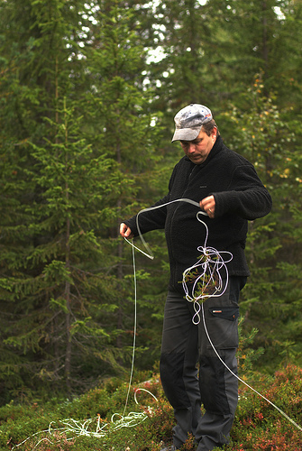
Field Day Simplified
Purpose of Field Day
Basic Rules
The Contact Exchange
Scoring
Station Setup
Strategies

Slide 3
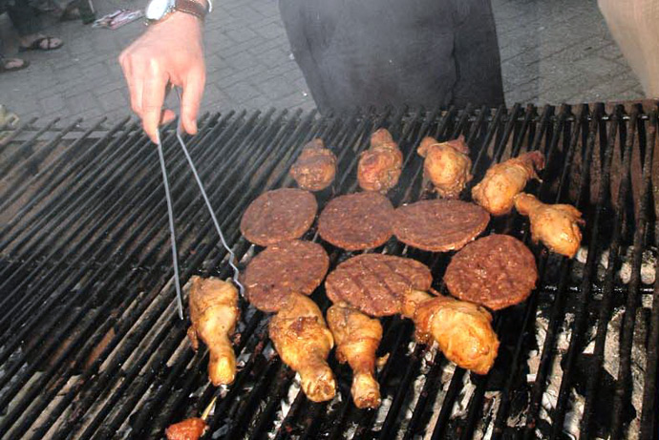
Field Day Purpose
Social gathering
Eating and drinking
Camaraderie and friendship
Camping
Weekend “getaway”
Emergency Preparedness
Training ourselves
Demonstrate emergency preparedness to public, government and served agencies
Experimentation with antennas, portable equipment and unusual power sources

Slide 4
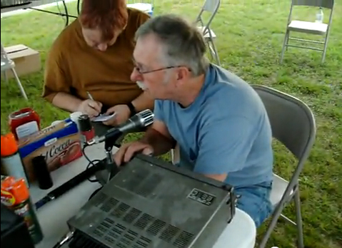
Field Day Purpose (cont.)
Chance to try out new/different equipment
Knowledge building
Recruiting new hams and potential members
Challenge of operating in abnormal situations and less-than-ideal conditions
Competition
FOOD AND FUN!

Slide 5
Objective of Field Day
To work as many stations as possible on any and all amateur bands (excluding the 60, 30, 17, and 12-meter bands – no repeaters) and to learn to operate in abnormal situations, in less than optimal conditions.
Field Day is open to all amateurs in the areas covered by the ARRL/RAC Field Organizations, and countries within IARU Region 2
DX stations residing in other regions may be contacted for credit, but are not eligible to submit entries.

Slide 6
Motivation
Many hams profess no interest in operating radio on Field Day, but in reality they’re reluctant to participate because of:
“Mike Fright” (or “Key Fright”)
Unfamiliar with radio procedures in general
No experience on HF (but ham radio is more than 2 meter repeaters)
“Don’t like contests”

Slide 7
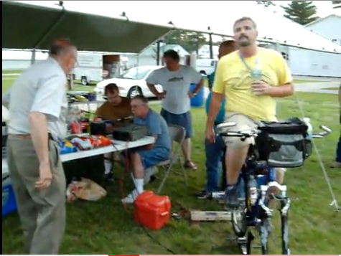
So…
What’s your excuse?
You don’t have to be a “super-ham” to operate Field Day
We’re here to help
you out. Don’t be
hesitant to ask.
You can “play” as little
or as much you’d like

Slide 8
WHO CAN OPERATE FIELD DAY?
ANYONE
LICENCED HAMS CAN OPERATE ON THEIR OWN UNDER THE NORMAL RESTRICTIONS OF THEIR LICENSE, OR ON UNDER THE PERMISSIONS OF A CONTROL OPERATOR
NEWLY-LICENSED OR NON-LICENSED PEOPLE ARE ENCOURAGE TO OPERATE THE GOTA STATION

Slide 9
What are we trying to accomplish?
Contact as many other stations as possible
On any and all amateur bands (excluding the 60, 30, 17, and 12 meter bands)
And in doing so, to learn to operate in abnormal situations in less than optimal conditions.
A premium is placed on:
developing skills to meet the challenges of emergency preparedness
acquainting the general public with the capabilities of Amateur Radio

Slide 10
Field Day Entry Categories
Are based on:
Number of transmitters
Total number of transmitters operating on Voice (SSB, AM, FM), CW (Morse Code) and Digital Modes
The Get On The Air (GOTA) station, along with a VHF/UHF station, do not count toward this number
Where the Station is located
In the “field”, at home, at an EOC, mobile, etc.
How Transmitters are powered
Emergency Power (Generators), Batteries, Solar, etc.

Slide 11
OUR OPERATION
We generally set up on Saturday morning, go through the night and then break down sometime on Sunday around noon.
New rules allow stations to start set-up as early as 0000Z Friday (8 PM Local Thursday), as long as we do not operate more than 24 hrs. of the 27.
Set up will begin Friday, June 27, at 2 PM
In the past we’ve operated two or three HF stations (2A/3A), plus a Get On The Air (GOTA) station for those with less radio experience
This year our goal is to operate 5A with a GOTA station and also operate a separate UHF/VHF station, as well as trying to make satellite contacts for bonus points

Slide 12
OUR OPERATION
We operate primarily on generators. The GOTA and VHF/UHF station can be powered by any means.
We should also look at using alternative energy sources (solar, for example) and make at least 5 contacts with that for bonus points.

Slide 13
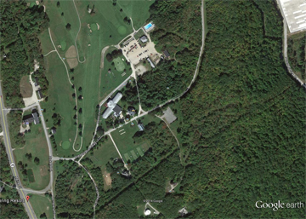
WHERE?
Poland Spring Resort

Slide 14
LOCATION, LOCATION, LOCATION
Why at Poland Spring Resort?
Location
Easy access
Plenty of room and facilities
680-700’ elevation
Public Access
Poland Spring Heritage Days and Strawberry Festival
(1,200 visitors last year) Did I mention strawberries?
More people = more potential GOTA operators/new hams/ new members
Poland Spring Resort owner & Festival committee want us there

Slide 15
THE BASIC RULES OF FIELD DAY
No new rules for 2014
All transmitters must be within a 1000 foot circle
All transmitters must use the same call – we’re currently exploring getting a 1x1 vanity call.
Except for the GOTA station which will use a separate call, usually that of the GOTA primary control operator

Slide 16
MORE RULES
No contact between a FD station and individual participant of that station
Radios cannot be used for more than one call sign during FD period (GOTA separate radio)
Phone, CW, and Digital are considered separate “bands”
All voice contacts (SSB, FM, AM, satellite) are equivalent (1 point each)

Slide 17
MORE RULES (continued)
All CW and digital contacts (PSK31, RTTY, Packet, Pactor, etc.) are equivalent (2 points each)
No cross--band contacts (exc. Satellite)
Only one xmtr per “band” at any time (exc. GOTA)
No contacts on repeaters or on 146.520 simplex

Slide 18
CONTACTS
Can only work each station once per band-mode:
For example, you can work the same station once on 20M phone, once on 20M CW, and once on 20M digital mode (total 5 points)
You can work the same station on other frequency bands and modes for additional points.

Slide 19
The Contact “Exchange”
In order to make a valid contact, the information to be exchanged consists of:
Number of transmitters at your site (3 for example)
Class of operation (A most commonly, F from EOC)
ARRL Section, State, Province or Part of State (ME for us)
So, for us:
On CW – “3A ME” or “2A ME” or “2F ME”, etc.
On Phone – “Three Alpha Mike Echo”

Slide 20
Exchange must be accurate
You must copy the information correctly from the other station AND…
The other station must copy your information correctly, OR ELSE…
It is not a valid contact and will be deducted from our final score

Slide 21
ARRL Section
71 US and 12 Canadian Sections
Basically each US state (PR and US VI) and Canadian province
Some states/provinces are divided into multiple sections:
Maine is all on section
Massachusetts is 2, Eastern and Western (EMA & WMA)
New Jersey is 2 sections, Northern and Southern
Texas is 3 sections
Ontario is now 3 sections
New York is 4 sections
California is 6, etc.

Slide 22
ARRL Sections (continued)
Each section has a unique 2 or 3 letter identifier.
Examples:
ME = Maine
EMA = Eastern Massachusetts
LAX = Los Angeles
WTX = West Texas
NFL = Northern Florida
List can be found at each station and is prominent on most logging software – keeps track of worked sections and ones still needed.

Slide 23
BONUS POINTS
DON’T JUST STAND AROUND – WORK ON THOSE BONUSES!
HERE’S WHY AND HOW:

Slide 24
BONUS POINTS
100% Emergency Power – 100 points per transmitter (except GOTA, VHF/UHF and Satellite)
Support equipment and peripherals (like computers, lights, etc.) can be on regular commercial power
Media Publicity – 100 points
Public Location – 100 points
Originating a Message to Section Manager – 100 points (usually sent through Seagull Net 5pm on 3.940)
Handling Messages – 10 points per, max 100 pts. – cannot be messages to Section Manager

Slide 25
BONUS POINTS
Satellite QSO (just 1) – 100 points
Demo of Natural Power – 100 points (bicycle generator, solar panel, wind turbine)
Need to make 5 contacts minimum
Counts as one of the transmitters while in use
Includes batteries charged by alternate power (like a solar panel, for example)
Copying the special CW FD Bulletin from W1AW. (must be copied over the air) – 100 points

Slide 26
BONUS POINTS
Site Visit by an invited Elected Government Official (know one?) – 100 points
Site Visit by Served Agency Group Rep. (Red Cross, Salvation Army, local EMA, Law Enforcement, etc.) – 100 points
Public Information Table – 100 points
Educational Activity (must be a “related to amateur radio” and a “formal activity”) – 100 points

Slide 27
BONUS POINTS
GOTA
Each GOTA participant may earn 20 points for every 20 contacts up to 100 points per participant. Each participant MUST make at least 20 contacts to earn bonus points. There is no partial credit or pooling of contacts. No single participant can earn more than 100 points.
The GOTA station can earn up to 500 points. You can make as many contacts as you want but the station can only earn a max of 500 points.
GOTA points double for a full-time GOTA coach

Slide 28
BONUS POINTS
Web Submission of Field Day entry (when sent in to the proper web sit) – 50 points
Youth Participation – 20 points for each participant age 18 or younger who completes at least one QSO
Max. of 100 points

Slide 29
Basic Field Day Operating Strategies
Search and Pounce (S&P)
You roam around the bands looking for other stations calling CQ
Calling CQ
You sit on an open frequency and call CQ waiting to others to respond

Slide 30
Search and Pounce (S&P)
You can be selective about who you contact
Useful in contests where multipliers are ARRL sections, DX zones
You can intentionally avoid stations with big pile ups (many stations calling the same station) which wastes time and reduce your “Q Rate” (number of contacts (QSOs) per minute or hour)
You must check the log to make sure the calling station is not a “Dupe” (duplicate of earlier QSO)

Slide 31
Calling CQ
You never know who will answer
May not work as many multipliers (sections)
Usually can work a lot more stations (more points, higher “Q Rate”)
Can be even easier using a voice keyer (recorded voice message)
May have to handle a pile-up (good practice for upcoming W1AW/1 operations)
Can get tiring if you call by voice and no one answers

Slide 32
Example of Good Phone Exchange
You call: CQ Field Day, CQ Field Day from W1NPP, Whisky One November Papa Papa
Someone answers: W1NPP here is November Four Alpha Whiskey Baker
N4AWB, please copy Three Alpha, Maine, Three Alpha Mike Echo, over
QSL, please copy Four Alpha, South Florida, Four Alpha SFL, over
QSL, thanks for South Florida and good luck in Field Day. QRZ from Whisky One November Papa Papa

Slide 33
Bad Example of Phone Exchange
You call: CQ Field Day, CQ Field Day from W1NPP, Whisky One November Papa Papa
Someone answers: W1NPP from November Four Alpha Whiskey Baker. Please copy Four Alpha South Florida
N4AWB didn’t give you a chance to get his call before he sent his exchange and section. You are probably still trying to type in his call and he’s wasting time by giving it all at once so you need to ask him to repeat.
Take your time and make sure you get everything right before moving on.
Saves time and increases points.

Slide 34
Phonetics on Phone
Phone operators must use the ITU Phonetics:
A = Alpha
B = Bravo
C = Charlie
D = Delta
Etc.
A sheet with a complete list is also at each station

Slide 35
OPERATING HINTS
Some good operating strategies for Phone, CW and Digital Modes

Slide 36
Hints for Working Phone
When Searching and Pouncing, enter calling station’s call in software FIRST, this way you don’t waste time calling a Dupe
Use phonetics for all of the exchange. Many people think the abbreviation for Maine is MA, and not ME. Saying Mike Echo helps avoid that confusion.
Repeat the other station’s exchange to make sure you got it right. “Thanks for South Florida” only takes an extra second and can help make sure you got it right the first time.

Slide 37
Hints for Working Phone
Don’t call at station with a pile up more than just a few of times. This wastes time and you can always come back to them later. Chances are, if they’re strong you’ll hear them again and, if they’re not, they won’t hear you anyway.
Don’t be long winded while calling CQ. Call a few times then listen. Call again if no one responds.
Keep your exchanges short and to the point. If you’ve been calling CQ, some stations will be impatient and leave before they call you if you’re going on about the weather and other stuff while they’re waiting.

Slide 38
Hints for Working Phone
Don’t be afraid to ask for repeats. If you can’t hear them the first time or forget to record it, just say, “Please repeat your… (call sign, section, etc.)” If you still can’t make it out, say, “Just you call, your call please” or “Just your section,” etc. That sometimes makes it easier to make out without all the other stuff you don’t need and saves time.
Don’t be afraid to repeat your own info if conditions are really bad. “Three Alpha Maine, Three Alpha Mike Echo…” etc. But don’t bother to repeat if conditions are good; it will only slow you down. Repeat only if asked when the other station is strong.

Slide 39
Hints for CW
Keep your calls brief:
A good CQ should be only: CQ FD CQ FD de W1NPP W1NPP k
A good reply to another station’s CQ should be: “THEIR CALL de W1NPP”
Or simply “W1NPP W1NPP” and let him call you.
When he gives you a call reply, “3A ME 3A ME W1NPP”
Sometimes he’ll call you and give his Exchange first. If so, reply, “QSL 3A ME 3A ME W1NPP”

Slide 40
Hints for CW
If you call CQ and someone answers, the you should send: “HISCALL 3A ME 3A ME de W1OCA”
Once he’s acknowledged and sent his Exchange, acknowledge him and move on: “QSL QRZ W1OCA”
Just like phone, don’t be shy about asking for repeats or fills. Everyone needs them now and then. If you don’t get it right, the whole contact has been a waste of both his time and yours. You BOTH have to get it right for it to count.

Slide 41
Hints for CW
Don’t be afraid to call a station who’s going faster than you can comfortably copy. Most of the time he’ll slow down to your speed. He wants the contact too!
Usually no need to repeat information unless asked. Giving your Exchange twice the first time is usually good practice to avoid being asked.
Listen carefully before attempting a contact or calling CQ. The bands are very busy during FD.
Like Phone, type in the other station’s call sign in before calling. You’ll save time if he’s a Dupe.

Slide 42
Hints for CW
Don’t hesitate to use software to do CW. If you can read and type, you can do CW.
Remember, it’s TWO points per valid contact as opposed to one for phone.
No one cares if you used a straight key, paddles or software. It all counts the same.
The Androscoggin IMAT van has computers with CW software and macros programmed so all you have to do is press the right button and copy down the other station’s call sign and exchange. Software does the rest!

Slide 43
Hints for Digital Modes
PSK31 and RTTY are the most popular Field Day Digital Modes
The macros for Field Day should be set up just like those for CW. In other words, CQ should be something like: “CQ FD CQ FD de W1NPP k”
No need for useless data like “thanks for…” or spelling out “MAINE”
Digital is a good use of the CW transmitter when there are no CW operators around. It’s easy and pretty foolproof if the right Macros are used.

